Slide 1
Jacuzzi and Swim Spa
A Swim Spa is a unit with a built-in current system that allows you to swim on the spot continuously.
This unit tend to be portable and self-contained, however swim units can be fitted to the side of swimming pools too.

Slide 2
Indoor and Outdoor Jacuzzi

Slide 3
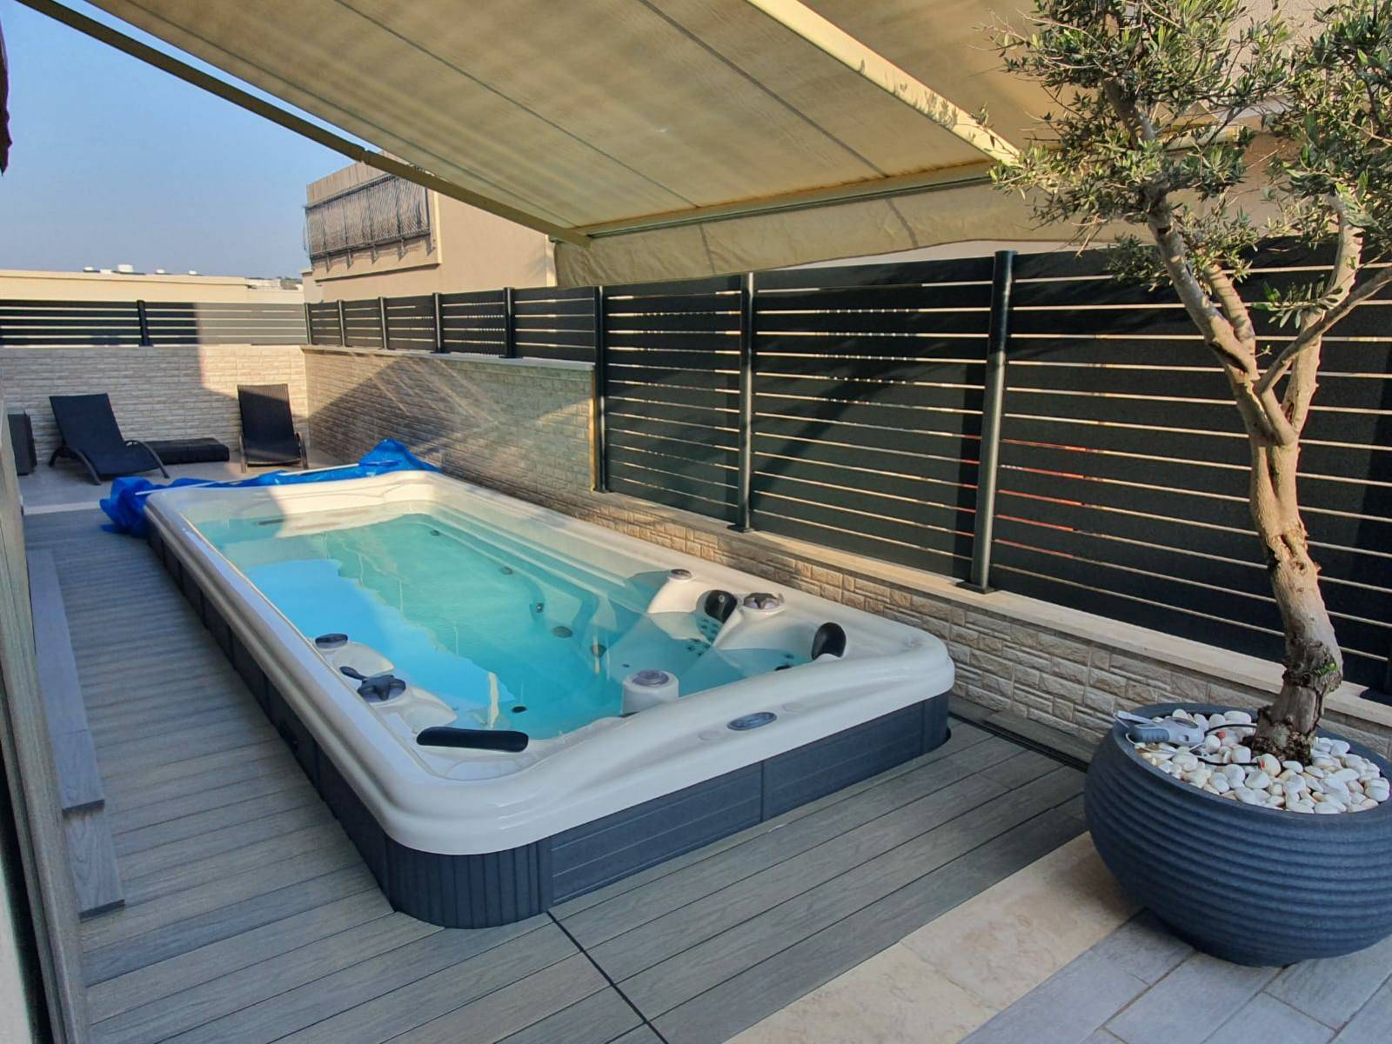

Slide 4
